Slide 1


OSA Certificate of Online Safety
Getting Started

Slide 2


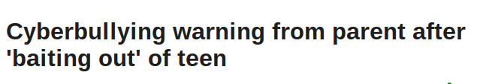
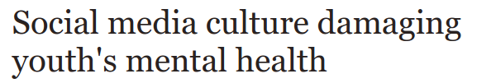
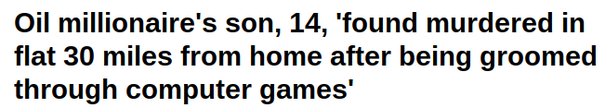
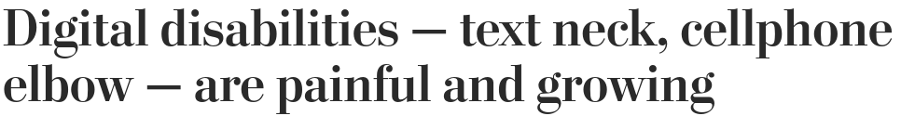
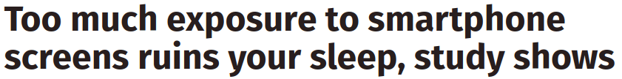

The OSA Certificate of Online Safety
Our digital devices have become incredibly important in our day-to-day lives and bring great opportunities and pleasure. However, the risks posed by these technologies to the health and safety of young people today are varied and very real. Sample recent headlines:

Slide 3


Logging in
In your browser visit www.onlinesafetyalliance.org
Press on the green button labelled ‘Certificate Log in’.

Slide 4
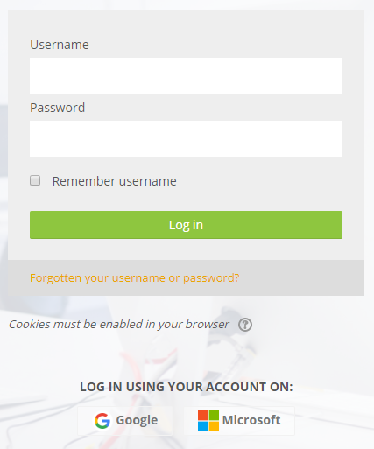
Logging in
Your school has chosen to use your school Microsoft accounts to access the OSA Certificate.
You need to click on the icon to log in with Microsoft.
You will then need to type in your school email address and password.
Do not type anything into the username and password boxes.

Slide 5
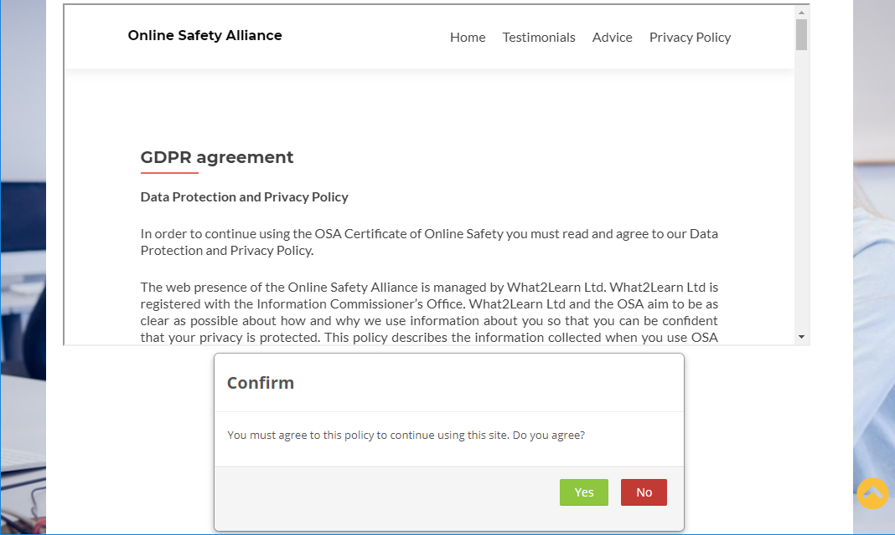
Logging in
The first time you log in you will be shown our data protection and privacy policy. You need to press the green ‘Yes’ button to agree to this before you can access the Certificate.

Slide 6
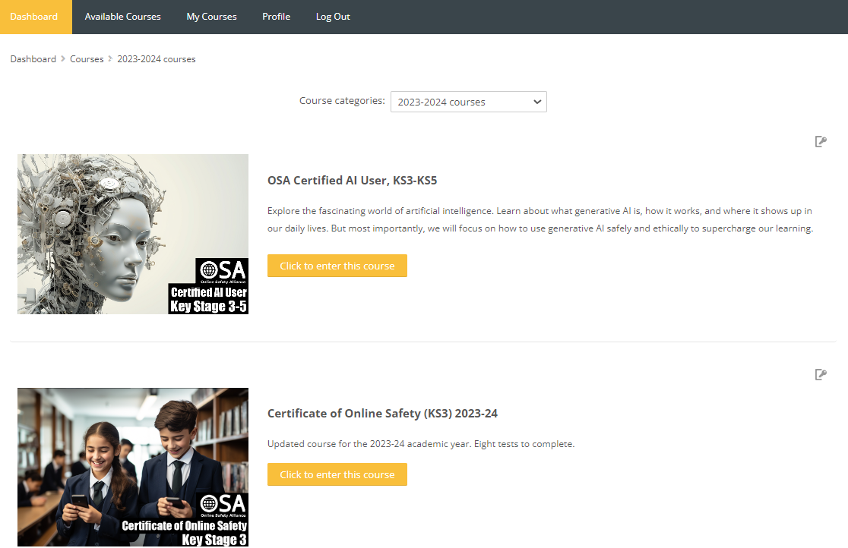
Accessing your course
- Select ‘Available Courses’ from the top navigation bar.
- Select 2023-24 courses’ from the drop down box.
- Then click to enter either the Key Stage 3, Key Stage 4 or Key Stage Key Stage 5 course (your teacher will tell you which to select).

Slide 7
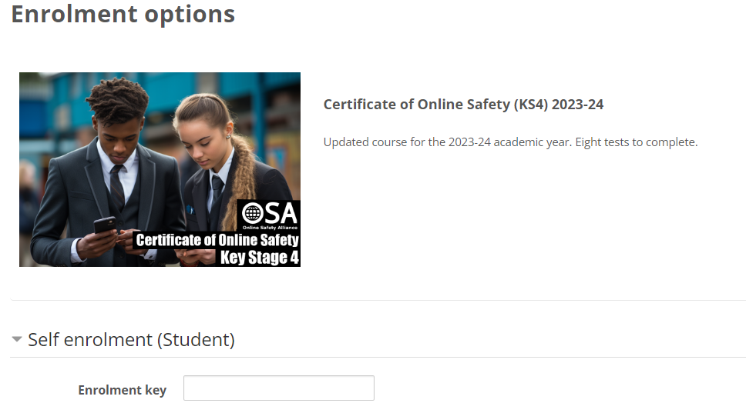
Accessing your course
The first time you access your course you will need to enter an enrolment key. Your teacher will tell you what this key is.
Type in the key and then press the green ‘Enrol me’ button.

Slide 8
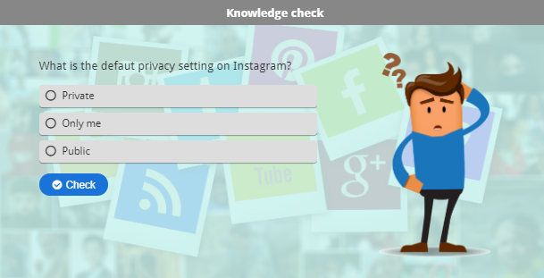
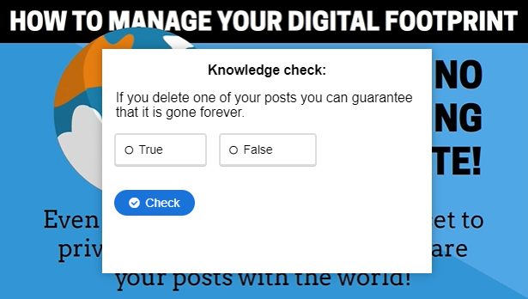
Completing your course
Activities marked ‘H5P’ are interactive activities that include a number of built-in knowledge checks. You must successfully answer at least 80% of these knowledge check tasks before the activity will be marked as complete.
Click the speaker icon on a page to have it read out to you.

Slide 9
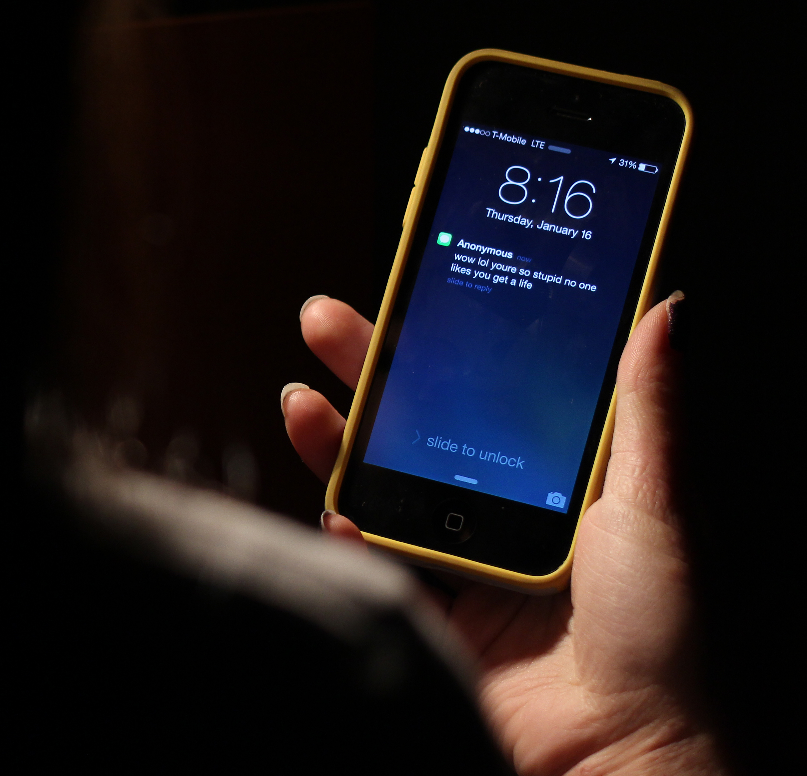
Completing your course
As you complete the Certificate you should think carefully about how your use of technology might make you vulnerable to a range of problems, both now and in the future.
You will also need to consider how your actions might impact, positively or negatively, on others.
Throughout this, you will reflect on how you use technology, what you might need to do differently, and what to do if you find yourself in a difficult situation.

Slide 10
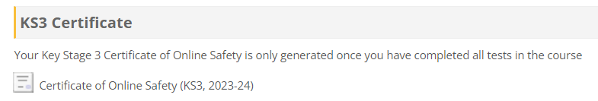

Claim your Certificate
At the bottom of your course you will see the link to generate your Certificate.
This will only be available to you once you have completed all assessments. Most assessments have an 80% pass mark, but you need to score 100% in the last one.

